Slide 1
New York Historic Homeownership Rehabilitation Credit Workshop
Presented By:
Parkside Community Association
March 11, 2023

Slide 2
Agenda
Eligibility
Determining the Scope of the Project
Application Part 1 & 2
Application Part 3
Claiming the Tax Credit
This workshop does not constitute legal, tax, or accounting advice, and the information provided is intended to be general in nature. Please ask questions!

Slide 3
Eligibility

Slide 4
What is the Tax Credit?
The Historic Homeownership Rehabilitation Credit program offers a state income tax credit equal to 20% of qualified rehabilitation expenses associated with repair, maintenance, and upgrades to historic homes. The value of the credit is applied to the NYS tax liability to reduce the amount a taxpayer will owe. The program covers 20% of qualified rehabilitation expenses up to a credit value of $50,000 per year.

Slide 5
Eligibility
There are two broad components of Tax Credit Eligibility:
eligibility of the home and
eligibility of the project.
To be eligible, a home must be an owner-occupied residential structure. Owner-occupied multi-family residential structures are eligible for the Tax Credit, but subject to reductions. These restrictions are not part of this workshop, but for more information contact Preservation Buffalo Niagara.

Slide 6
Eligibility of the Home
There are a number of additional eligibility requirements, but for Parkside purposes, practically all homes within the Parkside Community Association’s service area are eligible as contributing structures of the Parkside East Historic District. Vernon Triangle and Agassiz Circle (south of 198) are not currently eligible. A parcel map with all included houses can be found at https://cris.parks.ny.gov.

Slide 7
Eligibility of the Project
Total project spend must be at least $5,000
At least 5% of project spend must be on exterior work
Project must be approved by OPHRP before work begins
All project work must be “Qualified Rehabilitation Expenses”

Slide 8
Qualified Rehabilitation Expenses

Slide 9
Disallowed Expenses

Slide 10
Qualified Rehabilitation Expenses FAQs
OPRHP provides some additional FAQs on qualified expenses:
Replacement Windows are only qualified if the home’s existing windows are not historic or cannot be repaired due to severe deterioration. Vinyl or vinyl clad windows are never qualified expenses.
Vinyl Siding is also not a qualified expense. If the historic material cannot be repaired, in-kind replacement must be used.
Additionally, to be qualified, all project work must conform to the Secretary of the Interior Standards for Rehabilitation, which can be found at https://www.nps.gov/tps/standards/rehabilitation.htm.

Slide 11
Determining the Scope of the Project

Slide 12
What is a Project?
A project is any work or combination of work that meets the definition of eligibility: (1) occurring at an eligible property; (2) total spend exceeds $5,000; (2) at least 5% of project spend must be on exterior work; (4) approved by OPRHP before work begins; and (5) includes only Qualified Rehabilitation Expenses.
There is no fixed timetable for a project, and a project can be completed in only a few weeks or over several years. The Tax Credit will be applied for the tax year in which the project is completed.
A project can consist of a combination of many different types of qualified expenses performed by many different contractors.

Slide 13
Project Scoping Tips
Over Scope = Include work in the initial project scope that might not get completed. The Tax Credit program does not require that all proposed work be completed so long as the completed work, alone, satisfies the eligibility requirements. It’s easier to include work that might not be completed than to amend a proposed project to add work.
Combine Small Exterior Work with Pricey Interior Renovations = With expensive interior renovations like kitchens and bathrooms, consider also performing minor exterior work to qualify for the Tax Credit. For example, with a $30k kitchen renovation, spending an additional $1,600 on exterior work would make the entire $31,600 project eligible for the 20% ($6,320) Tax Credit.
Think about Timing = The Tax Credit is issued for the tax year in which the project is completed and issued based on the taxpayer’s personal tax return filing. So, if the goal is to claim a credit annually, think about what work can be completed by December 1 of the current year. Submission to OPRHP for approval by December 1 will ensure approval within the current tax year.
Once the scope of the project is determined, it’s time to move on to Parts 1 & 2 of the official application.

Slide 14
Application Part 1 &2

Slide 15
What is Part 1 & 2?
Calling it “Part 1 & 2” suggests that it is multiple forms: it is not. Part 1 & 2 is a single form that establishes project eligibility and the scope of the proposed project.
In Part 1 & 2, the applicant also provides descriptions and photographs of all areas of the home to be renovated or restored.
This Workshop will go through each section of the form.
All forms can be found at https://parks.ny.gov/shpo/tax-credit-programs/.

Slide 16
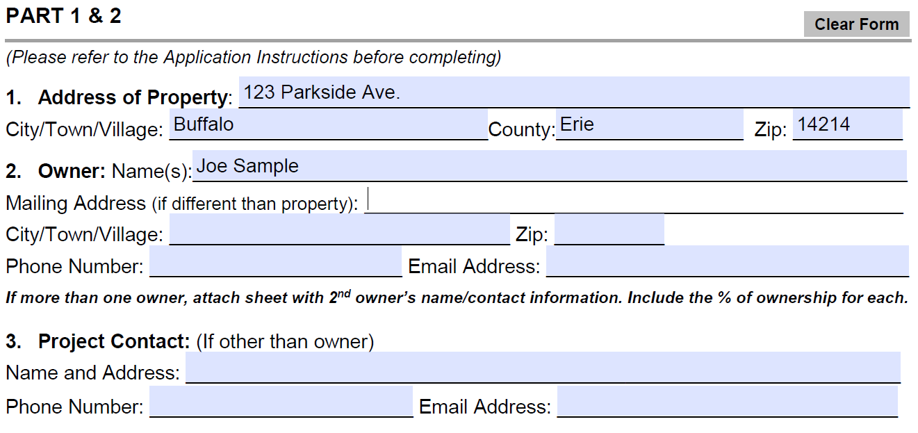
Sections 1-3
Sections 1-3 ask for basic homeowner contact information. Married couples may want to consult with a tax professional on the potential benefits of ‘married filing separately’ relative to the Tax Credit.

Slide 17
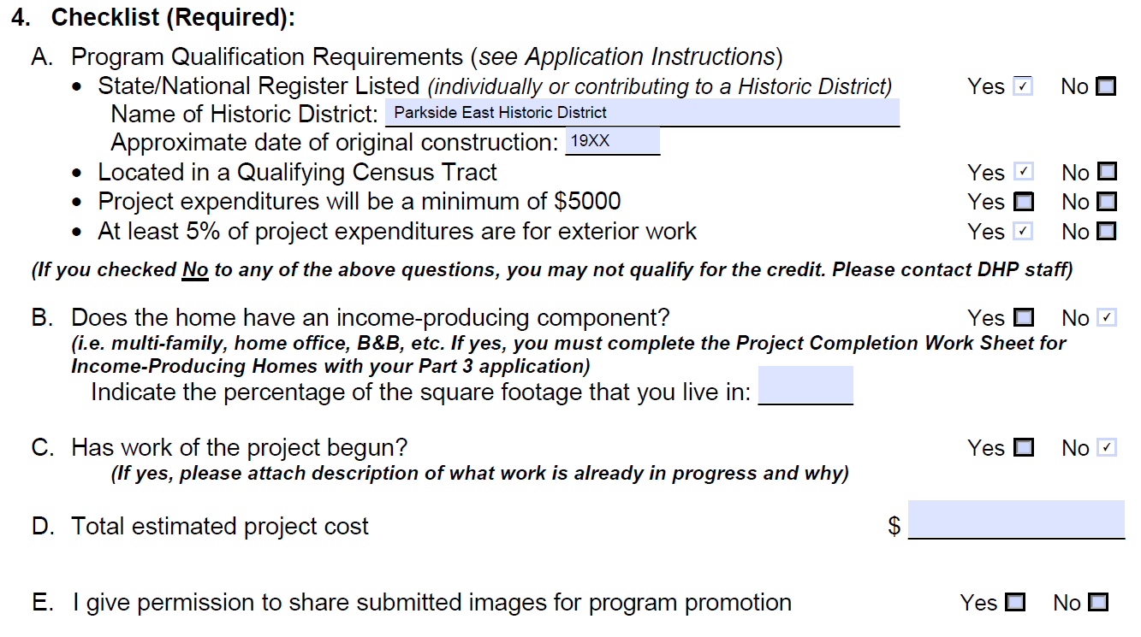
Section 4
Section 4 should be filled out like this:
Parkside East Historic District
19xx

Slide 18
Section 4 Additional Guidance
For the approximate date of construction, use The Parkside East Historic District Papers available on the PCA’s website. These papers contain an approximate date of construction and additional details about every structure in the Parkside East Historic District.
Work that has begun before submitting an application is not automatically disqualified. If some work has already begun, include a separate document with Part 1 & 2 that explains what work has already begun and why. OPRHP is quite flexible, especially if work needed to be addressed on an emergency basis (e.g., leaky roof, contractor scheduling restrictions, rodent infestation)

Slide 19
Section 5
Section 5 is a disclaimer that OPRHP has not provided tax advice:

Slide 20
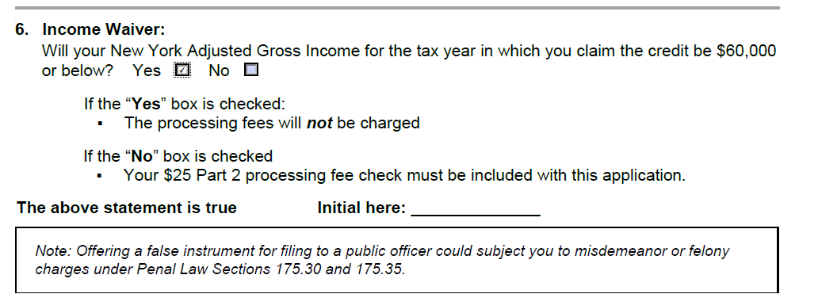
Section 6
For taxpayers that will have an AGI > $60k in the tax year in which the Tax Credit is claimed, there is a $25 fee to submit Part 1 & 2. Section 6 asks for certification:

Slide 21
Preparing to Submit the “Before” Photos
The next step, before completing additional sections of the form, is to submit photos of the current condition of the project work areas. This involves four steps:
Take photos of all exterior elevations of the home as well as all areas that will be affected by the proposed project
Rename the photographs as numbers, starting with the number 1
Draw a rough floor plan sketch of your home
Label on the floor plan where each of the numbered photographs were taken

Slide 22
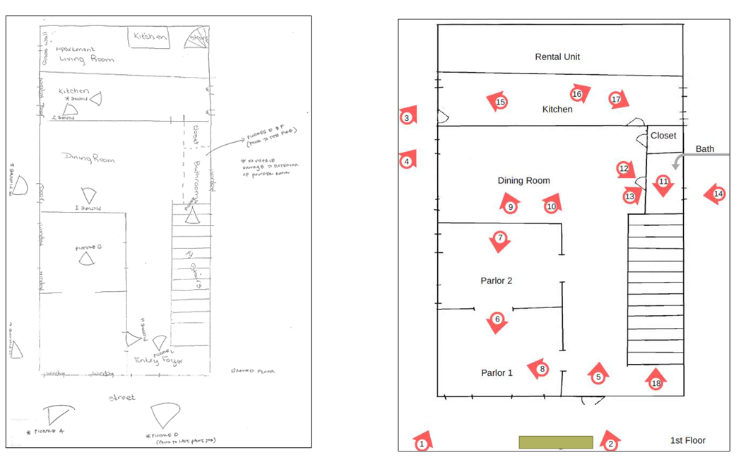
Example of Keyed Floor Plan
Keep a copy of the unnumbered floor plan for the final approval application and future years’ Tax Credit applications!

Slide 23
Sections 7 & 8
Section 8 is just a signature block, and Section 7 should be completed as follows (with $25 processing fee included only if AGI will be > $60k):

Slide 24
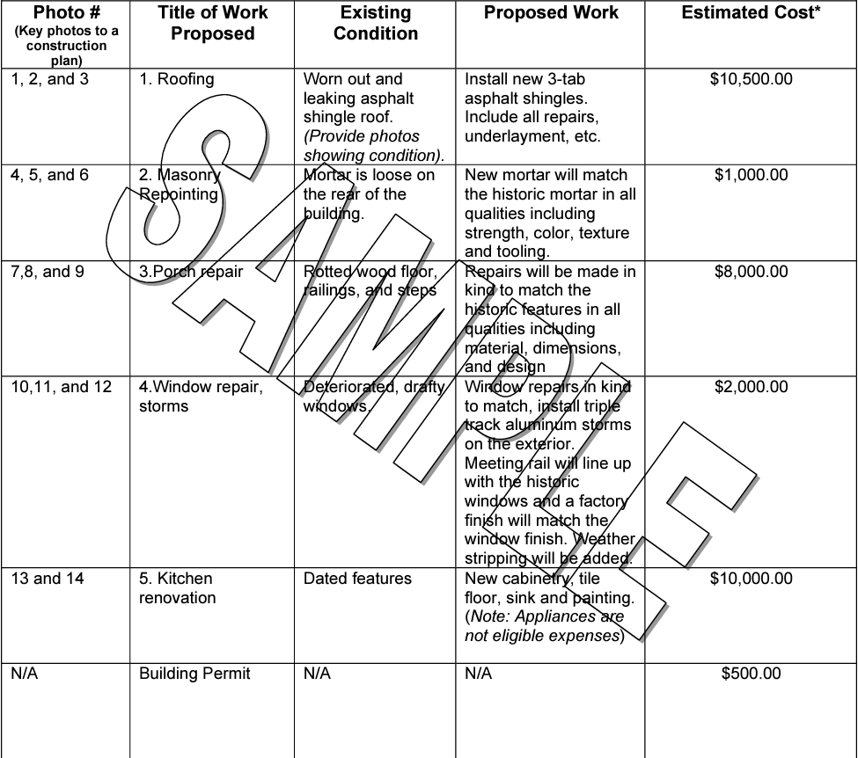
Completing Project Worksheets
With the keyed floor plan in hand, the next and final step is completing the Project Work Sheet. The estimated cost is simply ballpark. Here is a sample from OPRHP:

Slide 25
Submitting Part 1 & 2
There are now two ways to submit the Part 1 & 2 application:
Submit by mail, including a USB drive containing the photos and keyed floor plan, to: OPRHP, P.O. Box 189, Waterford, NY 12188
OR
Submit electronically at https://parks.ny.gov/shpo/tax-credit-programs/ by clicking “SUBMIT PART 1 & 2 APPLICATION”
All photos and floor plans are uploaded through the online form, which uses DocuSign.

Slide 26
After Submission
Once OPRHP receives the application, it has 30 days to review the submission. All communications from OPRHP will be via email. OPRHP will do one of the following:
Approve the project and provide a Project Number
Approve the project with conditions and provide a Project Number
Pose follow up questions or ask for clarification
Deny the application
Once a Project Number is issued, the project work can move forward. Keep the Project Number in a safe place, it will be needed later in the application process.

Slide 27
Amending
Submitted and approved projects can be amended. Amendments are only necessary to add work to the scope of the approved project; amendments are not necessary to remove work from the scope of a project. Amendments can be submitted by mail or electronically and are subject to the same review and approval process as initial Part 1 & 2 of the application.

Slide 28
Application Part 3

Slide 29
What is Part 3?
Part 3 is used to demonstrate to OPRHP that proposed and approved work has been completed; verify that the completed work meets Tax Credit eligibility requirements; and provide a final accounting of the work.
Part 3 can be submitted at any time so long as the completed work meets the definition of a “project”: at least $5,000 spent and at least 5% spent on exterior work. Work not completed can be included on future years’ Tax Credit applications.

Slide 30
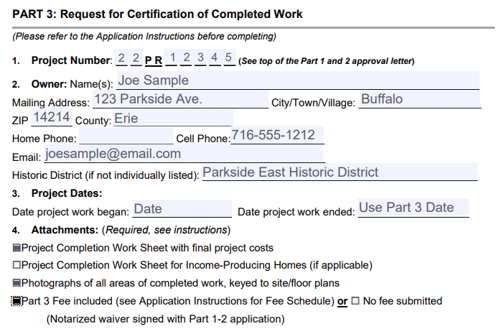
Sections 1-6
Sections 1-4 ask for contact and project information as well as a verification that the applicant has included the required materials; Sections 5-6 are signature verifications.

Slide 31
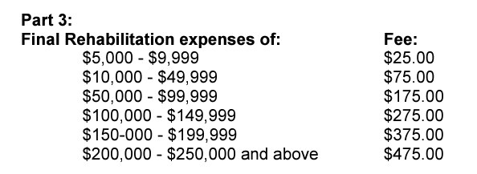
Fee Schedule
For applicants that will have an AGI > $60k in the tax year in which the Tax Credit is claimed, there is a Part 3 fee based on the final total rehabilitation expenses. There is no fee for applicants with an AGI < $60k. Payment must be included with the Part 3 submission.

Slide 32
Submitting the “After” Photos
The next step, before completing additional sections of the form, is to take photos of the current condition of all project work areas that were renovated or restored.
This involves four steps:
Take photos of all exterior elevations of the home as well as all areas that were renovated or restored
Rename the photographs as numbers, starting with the number 1
Get a copy of the rough floor plan sketch of your home that you made
Label on the floor plan where each of the numbered photographs were taken

Slide 33
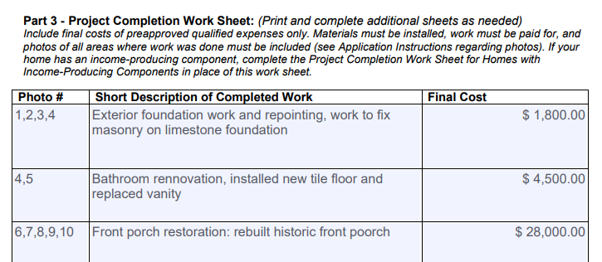
The Project Completion Work Sheet
With the keyed floor plan in hand, the next and final step is completing the Project Completion Worksheet. Identify which photographs apply to each item and provide a description and final accounting of the work completed.
Example:

Slide 34
Submitting Part 3
There are now two ways to submit the Part 3 application:
Submit by mail, including a USB drive containing the photos and keyed floor plan, to: OPRHP, P.O. Box 189, Waterford, NY 12188
OR
Submit electronically at https://parks.ny.gov/shpo/tax-credit-programs/ by clicking “SUBMIT PART 3 APPLICATION”
All photos and floor plans are uploaded through the online form, which uses DocuSign.

Slide 35
After Final Submission
Once OPRHP receives the application, it has 30 days to review the submission. All communications from OPRHP will be via email. If looking to claim the Tax Credit for the current Tax Year, submit Part 3 by no later than December 1.
So long as the work completed is consistent with the approved project and the spend is generally consistent with the work performed, OPRHP will issue a certification—it’s just a one-page letter—of completion. This certification is what is used when filing taxes.

Slide 36
Claiming the Tax Credit

Slide 37
Claiming the Credit
The Tax Credit form is filed with the individual’s New York State tax filing.
For taxpayers with an AGI < $60k, the Tax Credit will cancel out any NYS taxes owed, and the remainder will be refunded to the taxpayer.
For taxpayers with an AGI > $60k, the Tax Credit will cancel out any NYS taxes owed, and the remainder will be applied to future tax years.
The form to claim the Tax Credit is IT-237
Some self-preparation tax software will not support this form; FreeTaxUSA does support this form and is a recognized company by NYS
The Tax Credit amount is 20% of the total spend submitted on Part 3 and certified by OPRHP, with a maximum $50k credit

Slide 38
Questions?

Slide 39
Please Support the PCA
Thank you for attending. If you found value in the workshop, please consider making a donation to the PCA. You can use the QR codes below or go to the PCA website.
Questions can be sent to pcadirector@gmail.com

